Slide 1
THE INDIVIDUAL
DEPRIVATION MEASURE
A NEW TOOL FOR GENDER-SENSITIVE POVERTY MEASUREMENT
JO CRAWFORD
WORKSHOP ON GENDER AND POVERTY MEASUREMENT
SAN JOSE, COSTA RICA
30 AUGUST 2016

Slide 2
OVERVIEW
Introduction
What’s the problem?
Building from the ground up: the research underpinning the IDM
Features of the Individual Deprivation Measure
Using the IDM in Fiji – what the data can tell us
Readying the IDM for global use
Questions, discussion

Slide 3

TO LEAVE NO ONE BEHIND WE NEED TO MEASURE AT THE INDIVIDUAL LEVEL
Notes:
One of the 5 ‘big transformative shifts’ identified in the SDG process is to ‘Leave No One Behind’: ‘No person – regardless of ethnicity, gender, geography, disability, race or other status – is denied basic economic opportunities and human rights’
But we can’t accurately assess if ‘no one’ is left behind unless we are measuring poverty at an individual level.

Slide 4
Q: Is poverty feminising?
A: We don’t know
Notes:
Despite claims that poverty is feminising, or that women and girls make up the majority of the world’s poor, we don’t have the evidence that proves this one way or the other, because we’re not collecting poverty data about individuals.
20 years after the Beijing Declaration and Platform for Action stressed the importance of investing in sex disaggregated data the world continues to measure poverty at the household level – making it impossible to measure with accuracy whether women are poorer than men, or vice versa, and whether and how the nature of poverty varies by age, disability and other factors.

Slide 5
CURRENT POVERTY MEASURES
Did not involve women and men experiencing poverty in determining how poverty should be defined and measured
Are focused primarily on ‘headcount’
Measure at the household level, not the individual level, so cannot be accurately disaggregated by sex, age, disability & more, or reveal the impact of intersections
The IPL focuses on income, but other factors also matter
The MPI broadens the focus, drawing on existing data, but still collected predominantly at the household level
Notes:
This audience will know well the limitations of current poverty measures. This slide highlights a few
They are not grounded in the views of women and men with lived experience of poverty
They focus primarily on headcount, though latest MPI work focusing more on the nature and intensity of poverty
They don’t measure at the individual level – they can only estimate the poverty of individuals by using existing household data and dividing by the number of people in households

Slide 6

Poor / Not Poor hides information
US$ per day PPP
Are A & B equally poor?
Are C & D in the same situation?
How different are B & C?
Will A & B need the same things to be not poor?
Not poor
US$4.00
D
C
US$1.90
Poor
B
International Poverty Line
US$1.50
US$1.25
US$1.00
A
US$0.00
Notes:
Another problem with the IPL is that it shows people as either ‘poor’ or ‘not poor’
Categorising people as either ‘poor’ or ‘not poor’ treats A & B, & C & D as the same when their circumstances are different, and treats B & C as different when their circumstances are quite similar.
A binary approach means that important information about the extent of deprivation, or the level of vulnerability to falling into poverty, is lost. This is information that could inform policy and targeting.
Binary measures also create an incentive to focus on getting those just below the line over the line (because then they will no longer count as poor), rather than on the poorest people, whose circumstances may improve without making any difference to overall poverty statistics as measured by the IPL.

Slide 7
FROM CRITIQUE TO CHANGE
AN INTERNATIONAL RESEARCH COLLABORATION
IDM an output of an Australian Research Council Linkage Grant
(LP 0989385)
Housed and led by the Australian National University, with additional funding & in-kind support from:
International Women’s Development Agency
(linkage partner)
Oxfam Great Britain (Southern Africa), Oxfam America
Philippines Health & Social Science Association
University of Colorado at Boulder
  And significant additional support from Oslo University
Notes:
It was these limitations, and frustration at the inability to accurately assess the relationship between gender and poverty, that saw a cross-disciplinary international team set out to develop a better measure of poverty. Our research question was, what is a just and justifiable measure of poverty that is gender sensitive and capable of revealing gender disparities?
The research was based at the ANU with the support of the Australian Research Council, and involved a range of other partner organisations, notably IWDA , which was the industry linkage partner.

Slide 8
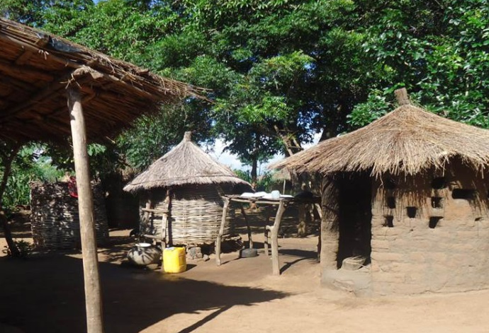
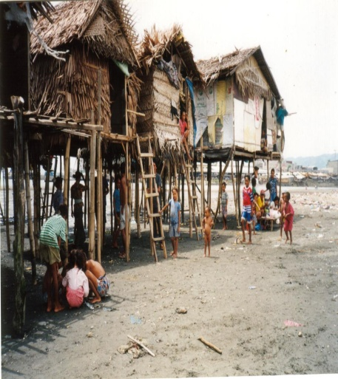
GROUNDED IN LOCAL CONTEXTS
6 COUNTRIES, 18 RESEARCH SITES
Pacific (Fiji)
South East Asia (Indonesia, Philippines)
Southern Africa (Angola, Malawi, Mozambique)
3 AGE COHORTS AT EACH SITE
Young women and men
Middle age women and men
Older women and men
Notes:
Field work was undertaken in six countries and three sites in each country (urban, rural, highly marginalised), for each of the first two phases of research. This work was led by local research teams, to prioritise contextual knowledge.
We explored issues with groupings of individuals at broadly similar life stages, because we know this impacts the nature of poverty and deprivation
These countries represent of range of circumstances and levels of poverty (based on existing measures).
However, a number of regions were not involved in the research, including Latin America.
Selection of countries was shaped by partners in the research, where they had existing relationships, and where there was interest to be involved in the research.

Slide 9
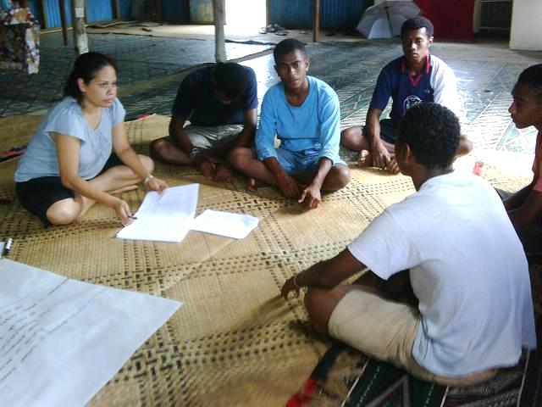
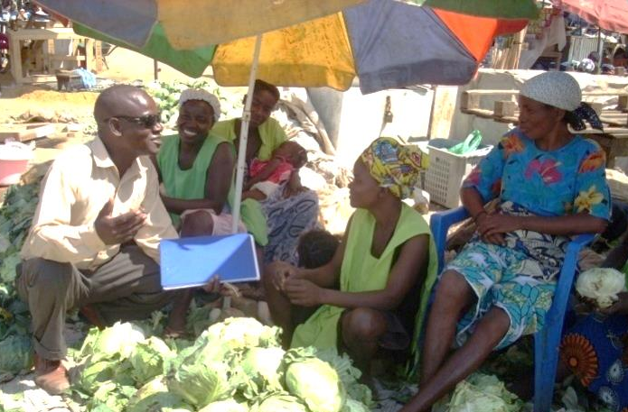
THREE-PHASE RESEARCH DESIGN
PHASE 1: QUALITATIVE
Participatory research, to gain insight & understanding (~ 1,115 people)
PHASE 2: RANKING
Dimension preference, to gauge priorities & gaps (~ 1,800 people)
PHASE 3: DEVELOPING AND TRIALLING
THE IDM
Nationally representative survey in the Philippines (~ 1,800 people)
Notes:
We conducted the research in 3 phases.
Phase 1: participatory, qualitative research in 3 sites in each country.
Phase 2: Participatory ranking; same countries, sites, age cohorts. Aim: to evaluate and rank top 15 dimensions of deprivation (out of 25 derived from Phase 1)
Phase 3: nationally representative ‘proof of concept’ trial of the new measure in the Philippines, conducted by a professional data collection firm
More than 4½ thousand people were involved across the three phases.

Slide 10
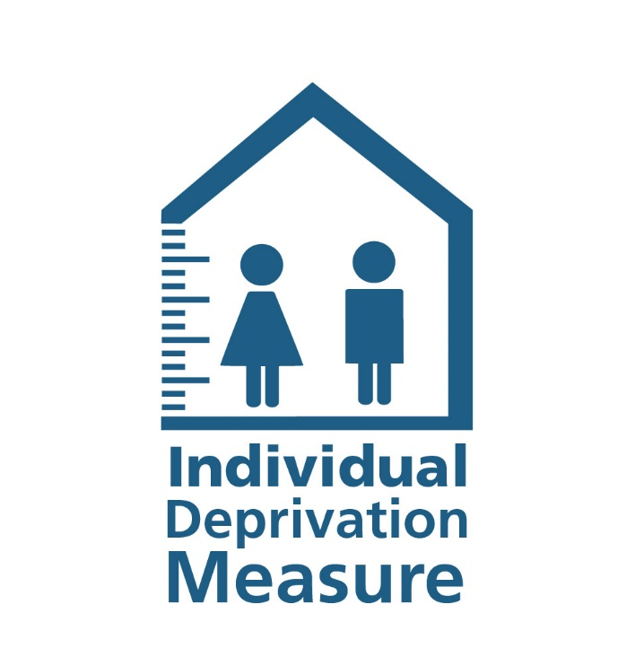
KEY FEATURES OF THE NEW MEASURE
Individual
Gender-sensitive
Multidimensional
Intersectional
Scalar
Policy relevant
Cost & time efficient
Grounded in participation
Notes:
These are the distinctive elements of the IDM.
The IDM is Individual, Gender sensitive, Multiidimensional, Intersectional, Scalar, Policy relevant, Cost and time efficient, and grounded in participation.
We’ll touch on each of these features.

Slide 11
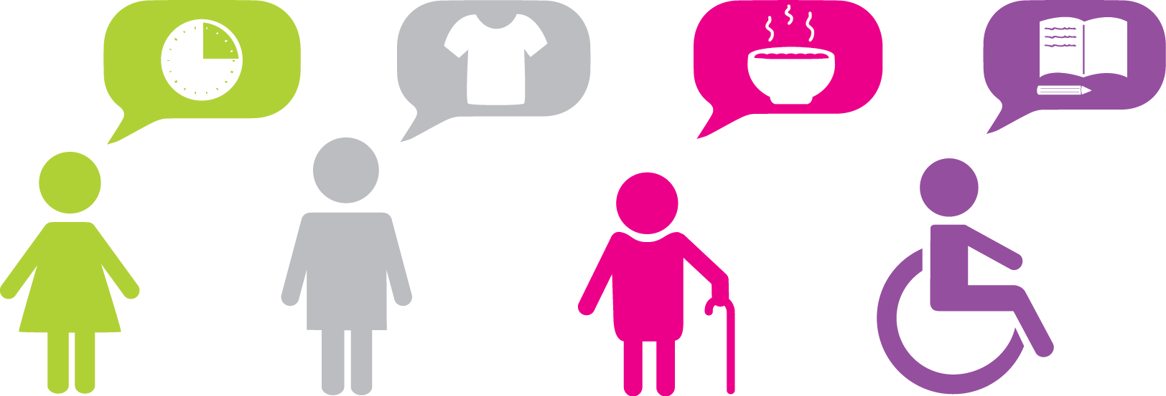
INDIVIDUAL, GENDER SENSITIVE, INTERSECTIONAL
By assessing individuals, not households, we can see:
The composition of poverty & how this varies, even at the same overall level of deprivation
Differences by gender, age, disability and ethnicity, including within households – and the impact of intersections between these characteristics
Horizontal inequalities between groups
Differences between women and men in each dimension, which can also be used to generate a poverty-relevant gender equity measure
LGBTQI oversampling, sensitivity testing with advocacy groups in Nepal and Fiji will help strengthen IDM & move beyond gender binaries
Notes:
Individual measurement allows us to examine how group identities and associated social and economic access interact to produce deprivation (at any level of analysis, e.g., sex x disability within a particular region).
We can identify the gender gap in each dimension, and use this to construct a poverty-relevant measure of gender equity.
The IDM uses the Washington Group Short Questions on Disability to capture data on disability.
The IDM also uses an innovative approach to sampling to capture intra-household differences. Understanding the intra-household distribution of deprivation requires moving beyond the standard technique of having one knowledgeable household member answer on behalf of every member of the household.
We randomly select households, then aims to interview every adult member of the household.
This enables us to see differences in deprivation within a household, including by sex, age, disability, ethnicity and self-identified minority status.
This brings with it important ethical issues

Slide 12
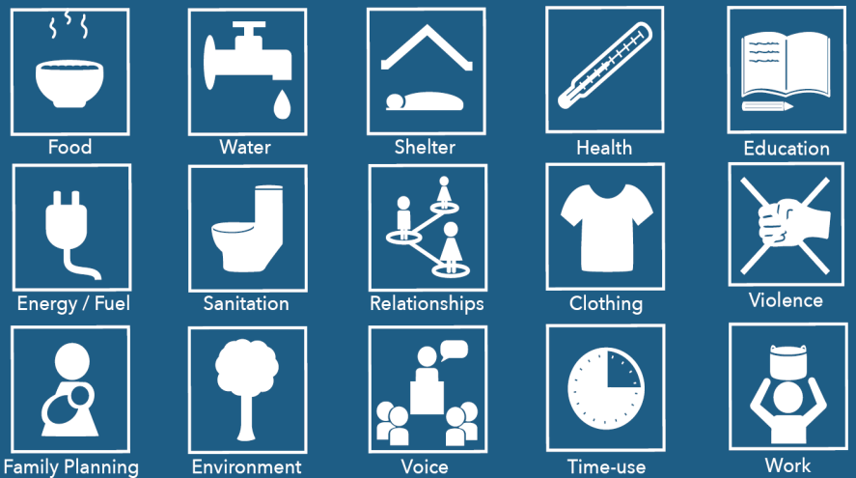
MULTIDIMENSIONAL
Notes:
The IDM expands the definition of poverty to cover 15 key dimensions of life that poor women and men consider important to defining poverty and to moving out of poverty
It considers a wider range of dimensions than existing measures, including ones particularly important to poor women, such as voice, agency, social relationships, access to contraception, freedom from violence, and time use/labour burden.
The three rows reflect the dimensions that were most consistently ranked as highest, middle, and lower though still important priorities in the phase 2 participatory ranking process
These priorities are also reflected in the weighting system initially recommended for the IDM. We are looking closely at approaches to weighting with the aim of both respecting the priorities of participants in the original research and supporting the effectiveness and sensitivity of the measure overall.

Slide 13
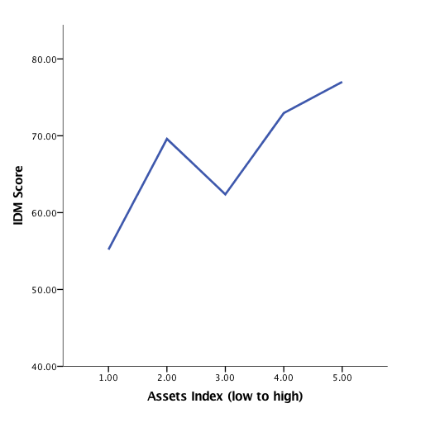
INCLUDES FINANCIAL STATUS
On the x axis, financial status (as measured through a simple asset index at the household level)
On the y axis, the IDM Score
The graph shows the relationship between financial deprivation and multidimensional deprivation in Fiji
Notes:
Monetary poverty is obviously an important component of poverty, and the lack of income and wealth was emphasized by participants in the first phase of research.
Our approach is to take account of both multi-dimensional deprivation and financial deprivation, in a way that makes each visible, adopting the approach of the Mexican multidimensional poverty measure. A simple assets index is used as the indicator of financial status.
I’ll come back to the Fiji results a little later

Slide 14
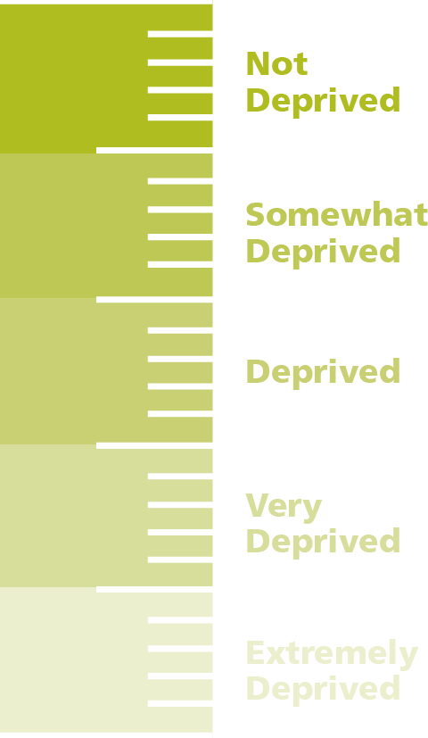
SCALAR: MEASURES INTENSITY OF POVERTY
Gets beyond ‘poor’ / ‘not poor’
Deprivation-focused, not a well-being measure
Can show progressive changes in circumstances
Recognises that what is needed to be not poor depends on how poor you are to start with
Indicator 1:
CONTROL OVER PERSONAL DECISION-MAKING
Notes:
The IDM moves beyond the limitations of a binary ‘poor/not poor’ measure, using a 1-5 scale to identify the depth of deprivation
Will enable better understanding of the nature of poverty ,
Can help targeting

Slide 15

COST AND TIME EFFICIENT
An individual survey takes 60 minutes
Conducted with all adults in a household
Notes:
The IDM is cost and time efficient An Individual survey takes around 60 minutes.
One person in the household also completes a household survey, that takes about 30 minutes. For that person, the total time commitment is around 90 minutes to 2 hours.
We are digitizing the IDM survey for Nepal and expect this to shorten survey completion times.
Sample approach of randomly selecting households and then seeking to every adult member does add to the time in the field, as it often requires a number of call-backs to reach all adult household members.

Slide 16
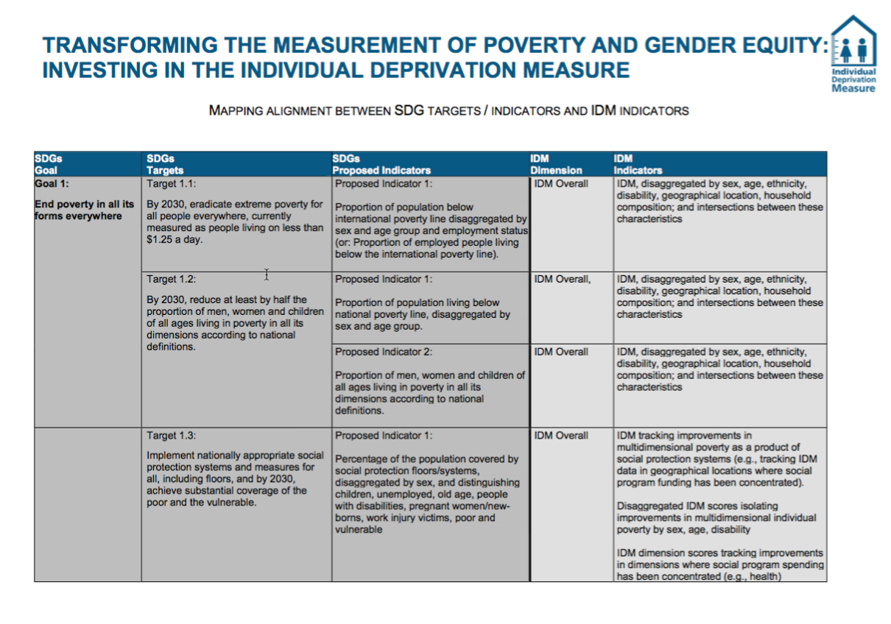
POLICY RELEVANT
Notes:
Particularly in resource constrained settings, the IDM could provide a cost-effective way to assess how a focus on the Global Goals is translating into changed lives for individual women and men, in relation to key economic and social dimensions – and who is being left behind.
More granular and gender-sensitive information could help to reinforce and accelerate change, enabling better targeting of investments and closer tracking of change.
Our experience with IDM data in Fiji following Tropical Cyclone Winston suggests it also has value to support organisations responding to humanitarian emergencies and natural disasters.
Not everyone is equally vulnerable or resilient, and poor people are not all poor in the same way; individual level data can help targeting of support. Natural disasters also provide an opportunity to build back better – if you know where there was particular disadvantage before a disaster, emergency and subsequent development responses can seek to address these going forward.

Slide 17
HOW IT WORKS
OVER 90 = NOT DEPRIVED
80-89.99 = SOMEWHAT DEPRIVED
70-79.99 = DEPRIVED
60-69.99 = VERY DEPRIVED
BELOW 60 = EXTREMELY DEPRIVED
OVERALL IDM SCORE
Notes:
OK – the next few slides take us inside the IDM and how it works. In the interests of time, I’ll focus on some in more depth than others – but you will have the slides and I can come back to anything you want to discuss.
Then I want to illustrate what you can do with the IDM by showing some data from the Fiji study.
At its simplest, the dimension scores are aggregated to create an overall IDM score out of 100. This score locates an individual in a category of deprivation. These categories and their associated thresholds are informed by the levels of poverty participants identified in in the participatory phase of the IDM research and were validated against results in the Philippines trial.

Slide 18
HOW IT WORKS
HEALTH DIMENSION
10 = NOT DEPRIVED
9 = SOMEWHAT DEPRIVED
7 = DEPRIVED
4 = VERY DEPRIVED
0 = EXTREMELY DEPRIVED
Indicator 1:
HEALTH STATUS
Indicator 2:
HEALTH CARE ACCESS
Indicator 3:
HEALTH CARE QUALITY
Q 1.1: When was the last time you had a significant injury or illness?
Q 2.1: The last time you had an injury or illness that needed health care, did you receive it?
Q 3.1: Were there any problems with the following:
Skill of practitioner
Cleanliness of facility
Availability of prescribed treatment
Level of respect
Waiting time
Location of provider
Q 1.2: Did this injury or illness make it impossible or very difficult to perform your usual paid or unpaid activity?
Q 2.2: From whom did you receive health care? [traditional healer; health worker; midwife; nurse; medical doctor; dentist; physiotherapist]
Q 1.3: How long was it difficult or impossible for you to perform your usual paid or unpaid activity?
Notes:
The next slide drills down into the health dimension.
Underlying each dimension are indicators and questions, which are converted from categorical to interval data.
We use the best available current evidence about appropriate indicators to measure in each dimension, drawing on well validated indicators and questions from existing surveys wherever possible. Cost/feasibility was a qualifying criteria.
However, this work was done around 2012, and we know that developments in this field have continued apace, and so as we go forward we are very keen to partner with individuals and organisations with expertise

Slide 19
HOW IT WORKS
RELATIONSHIPS DIMENSION
RELATIONSHIPS DIMENSION
10 = NOT DEPRIVED
9 = SOMEWHAT DEPRIVED
7 = DEPRIVED
4 = VERY DEPRIVED
0 = EXTREMELY DEPRIVED
Indicator 1:
CONTROL OVER PERSONAL
DECISION-MAKING
Indicator 2:
PERSONAL
SUPPORT
Q 1.1: In general, how much control do you have over personal decisions that have a major impact on your life, such as when you go out of the house into the community, with whom you associate, or from when and where you seek health care?
Q 2.1: If you were in trouble, how much support could you rely on from friends and family?
Notes:
The IDM not only measures material deprivation. Social and personal aspects of poverty, such as control over decision-making, personal support (and, not pictured, being able to dress in a way that is in line with the standards of one’s community; having a voice in the community, and a sense of efficacy in enacting change; being respected for paid and/or unpaid work, and more).

Slide 20
HOW IT WORKS
OVER 90 = NOT DEPRIVED
80-89.99 = SOMEWHAT DEPRIVED
70-79.99 = DEPRIVED
60-69.99 = VERY DEPRIVED
BELOW 60 = EXTREMELY DEPRIVED
OVERALL IDM SCORE
INDICATOR
INDICATOR
INDICATOR
QUESTION
QUESTION
QUESTION
QUESTION
QUESTION
QUESTION
Notes:
As all individuals are surveyed on all dimensions, connections between dimensions can also be explored through correlations and cross-tabulations.
We can see the association between different aspects of poverty for individuals, groups, regions, and nationally, to identify multiple priority areas simultaneously.

Slide 21
LEVELS OF ANALYSIS
OVER 90 = NOT DEPRIVED
80-89.99 = SOMEWHAT DEPRIVED
70-79.99 = DEPRIVED
60-69.99 = VERY DEPRIVED
BELOW 60 = EXTREMELY DEPRIVED
LEVEL OF ANALYSIS
NATION
REGION
TIKINA
SETTLEMENT TYPE
HOUSEHOLD
INDIVIDUAL
OVERALL IDM SCORE
INDICATOR
INDICATOR
INDICATOR
QUESTION
QUESTION
QUESTION
QUESTION
QUESTION
QUESTION
Notes:
Moving now to levels of analysis, on this slide you can see we can explore IDM data at any level, from national through regional, tikina (administrative district), to household or individual as well as by settlement type (urban, rural, informal settlement).

Slide 22
DISAGGREGATION
OVER 90 = NOT DEPRIVED
80-89.99 = SOMEWHAT DEPRIVED
70-79.99 = DEPRIVED
60-69.99 = VERY DEPRIVED
BELOW 60 = EXTREMELY DEPRIVED
LEVEL OF ANALYSIS
NATION
REGION
TIKINA
SETTLEMENT TYPE
HOUSEHOLD
INDIVIDUAL
OVERALL IDM SCORE
DISAGGREGATION
SEX
AGE
ETHNICITY
DISABILITY
INDICATOR
INDICATOR
INDICATOR
QUESTION
QUESTION
QUESTION
QUESTION
QUESTION
QUESTION
Notes:
The data can also be disaggregated by demographic factors such as sex, age, ethnicity and disability, and intersections of these – though this will be influenced by sample size

Slide 23
INTERSECTIONALITY
OVER 90 = NOT DEPRIVED
80-89.99 = SOMEWHAT DEPRIVED
70-79.99 = DEPRIVED
60-69.99 = VERY DEPRIVED
BELOW 60 = EXTREMELY DEPRIVED
LEVEL OF ANALYSIS
NATION
REGION
TIKINA
SETTLEMENT TYPE
HOUSEHOLD
INDIVIDUAL
OVERALL IDM SCORE
DISAGGREGATION
SEX
AGE
ETHNICITY
DISABILITY
INTERSECTIONALITY
AGE X SEX
ETHNICITY X SEX
DISABILITY X ETHNICITY - WITHIN DISTRICT
SETTLEMENT TYPE X DISABILITY X AGE
INDICATOR
INDICATOR
INDICATOR
QUESTION
QUESTION
QUESTION
QUESTION
QUESTION
QUESTION
Notes:
Individual measurement allows for examining intersectionality – how group identities interact within an individual to produce deprivation (at any level of analysis, e.g., sex x disability within a particular region).

Slide 24
IDM FIJI STUDY 2015-16
Funded by DFAT Pacific Women Shaping Pacific Development (PWSPD)
Implemented by IWDA, Fiji Bureau of Statistics
Survey in poorer regions of Fiji (WB 2011)
1125 households across 75 Enumeration Areas
Draft study report ready for stakeholder input and reviewed
  And informing current & planned refinement work
Notes:
Now I’ll take you through some slides presenting data from a study in Fiji in 2015 using the IDM.
Since the ARC research to develop the IDM finished in late 2013, IWDA has worked with the Fiji Bureau of Statistics to undertake an IDM study in Fiji, in order to explore the nature of poverty in some of the poorest areas identified by the World Bank in its 2011 poverty mapping study. The research was funded by the Australian Government.
This work has enabled some refinement of tools, data frameworks, syntax for analysis, & further consideration of weighting options.
It has also enabled us to see the real power of the IDM to paint a fine-grained picture of the nature and depth of poverty.

Slide 25
FIJI EXAMPLE
FIJIAN SAMPLE 77.69
70-79.99 = DEPRIVED
LEVEL OF ANALYSIS
NATION
REGION
TIKINA
SETTLEMENT TYPE
HOUSEHOLD
INDIVIDUAL
DISAGGREGATION
SEX
AGE
ETHNICITY
DISABILITY
INTERSECTIONALITY
AGE X SEX
DISABILITY X SEX
TIKINA X ETHNICITY
URBAN/RURAL X DISABILITY
Notes:
The Fiji sample was not a national sample but a targeted sample in previously identified poverty hotspots. The aim was to maximise the value of the sample, to see what more could be revealed using the IDM. However, it does give us a sense of the distribution of poverty that is enabled by scalar data.

Slide 26
FIJI EXAMPLE
MEN 78.20
WOMEN 77.18
70-79.99 = DEPRIVED
LEVEL OF ANALYSIS
NATION
REGION
TIKINA
SETTLEMENT TYPE
HOUSEHOLD
INDIVIDUAL
DISAGGREGATION
SEX
AGE
ETHNICITY
DISABILITY
INTERSECTIONALITY
AGE X SEX
DISABILITY X SEX
TIKINA X ETHNICITY
URBAN/RURAL X DISABILITY
Notes:
This slide breaks down the overall picture of IDM poverty by sex. Women have a lower average score than men, & this was statistically significant.
You can see that there are more women in the two lowest categories (extremely & very deprived) and fewer women than men in the two less deprived/not deprived categories.

Slide 27
FIJI EXAMPLE
LEVEL OF ANALYSIS
NATION
REGION
TIKINA
SETTLEMENT TYPE
HOUSEHOLD
INDIVIDUAL
DISAGGREGATION
SEX
AGE
ETHNICITY
DISABILITY
INTERSECTIONALITY
AGE X SEX
SETTLEMENT TYPE X SEX
TIKINA X ETHNICITY
URBAN/RURAL X DISABILITY
Notes:
Intersection between sex and settlement type is presented in this graph - the IDM produces graphs that allow an easy evaluation of where gender difference is greatest (in this case, a noticeable gender difference in urban centers, but not rural or informal settlements)

Slide 28
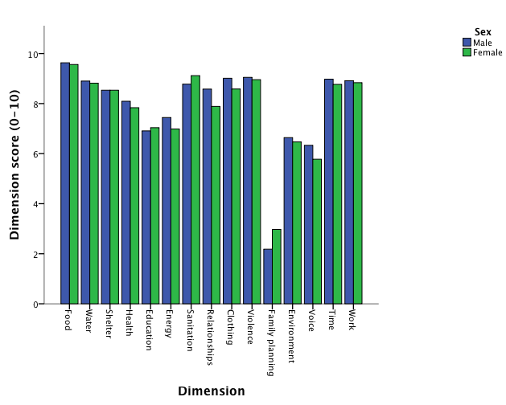
FIJI EXAMPLE
LEVEL OF ANALYSIS
NATION
REGION
TIKINA
SETTLEMENT TYPE
HOUSEHOLD
INDIVIDUAL
DISAGGREGATION
SEX
AGE
ETHNICITY
DISABILITY
INTERSECTIONALITY
AGE X SEX
SETTLEMENT TYPE X SEX
TIKINA X ETHNICITY
URBAN/RURAL X DISABILITY
Notes:
Gender differences within each dimension can also be examined. This illustrates the importance of individual-level measurement and selection of dimensions that are gender-sensitive
We can see that one dimension with significant gender inequality is voice.
Also family planning – but we think this tells us more about some technical issues with the questionnaire than actual differences in deprivation in Fiji.
And even within dimensions, we find, for example that women reported less control over decisions that affected them than men reported in the relationships dimension. Men on the other hand reported less personal support than women in this dimension.
These findings can guide us about how gender inequalities need to be addressed.

Slide 29
FIJI EXAMPLE
TARGET
HEALTH CARE ACCESS
LEVEL OF ANALYSIS
NATION
REGION
TIKINA
SETTLEMENT TYPE
HOUSEHOLD
INDIVIDUAL
HEALTH STATUS
HEALTH CARE QUALITY
50% sample had injury/ illness in previous year
Saw doctor:
92% men; 84% women
Caused work absence:
60% men;
50% women
Issue with practitioner skill: 3.4% men;
7.4% women
DISAGGREGATION
SEX
AGE
ETHNICITY
DISABILITY
INTERSECTIONALITY
AGE X SEX
SETTLEMENT TYPE X SEX
TIKINA X ETHNICITY
URBAN/RURAL X DISABILITY
Notes:
This slide illustrates the ability to drill down into dimensions to see WHY a gender difference is emerging.
Here, we see that although men and women get sick and injured at around the same rate, women—especially young women—are less likely to seek health care, less likely to see a doctor if they do, and more likely to report problems with health care quality.

Slide 30
FIJI EXAMPLE
LEVEL OF ANALYSIS
NATION
REGION
TIKINA
SETTLEMENT TYPE
HOUSEHOLD
INDIVIDUAL
DISAGGREGATION
SEX
AGE
ETHNICITY
DISABILITY
INTERSECTIONALITY
AGE X SEX
SETTLEMENT TYPE X SEX
TIKINA X ETHNICITY
URBAN/RURAL X DISABILITY
Notes:
The intersection between sex and age is presented here, illustrating that the largest gender difference is in younger age groups.

Slide 31
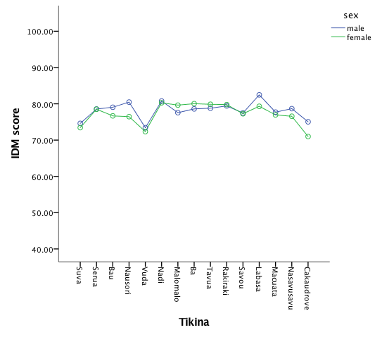
FIJI EXAMPLE
LEVEL OF ANALYSIS
NATION
REGION
TIKINA
SETTLEMENT TYPE
HOUSEHOLD
INDIVIDUAL
DISAGGREGATION
SEX
AGE
ETHNICITY
DISABILITY
INTERSECTIONALITY
AGE X SEX
SETTLEMENT TYPE X SEX
TIKINA X ETHNICITY
URBAN/RURAL X DISABILITY
Notes:
We can look at the variation by sex and geography, identifying where the gender difference is greatest, and providing easily interpretable information for designing targeted responses.

Slide 32
FIJI EXAMPLE
SOURCE OF COOKING FUEL
LEVEL OF ANALYSIS
NATION
REGION
TIKINA
SETTLEMENT TYPE
HOUSEHOLD
INDIVIDUAL
DISAGGREGATION
SEX
AGE
ETHNICITY
DISABILITY
INTERSECTIONALITY
AGE X SEX
DISABILITY X SEX
TIKINIA X ETHNICITY
URBAN/RURAL X DISABILITY
Notes:
This shows the prevalence of different kinds of cooking fuel by settlement type in the Fiji sample – again, if you are interested in the health impacts of fuel, decision makers can use the IDM to help determine priorities and guide targeted interventions

Slide 33
FIJI EXAMPLE
LEVEL OF ANALYSIS
NATION
REGION
TIKINA
SETTLEMENT TYPE
HOUSEHOLD
INDIVIDUAL
DISAGGREGATION
SEX
AGE
ETHNICITY
DISABILITY
INTERSECTIONALITY
AGE X SEX
SETTLEMENT TYPE X SEX
TIKINA X ETHNICITY
URBAN/RURAL X DISABILITY
Notes:
I’ve got two more Fiji illustrations to show you. This graph illustrates the importance of intra-household measurement, showing that individuals within a household have different overall IDM scores, and different profiles of deprivation.

Slide 34
FIJI EXAMPLE
OVERALL IDM = 66.61 (VERY DEPRIVED)
CASE 1
The first participant is an older woman who speaks Hindi and practises the Hindu religion. She lives in a rural area outside Lautoka with her spouse. She works unpaid in the household, and never attended school. She experiences some functional difficulties. Their household assets index is relatively high, and she self-rates as ‘somewhat poor’. Yet she often has no food due to lack of resources, and only sometimes has enough water to meet her personal needs. She was sick recently, but received healthcare from a doctor. Her toilet is a pit with no slab, and she feels no capacity to voice her opinions or bring about change in her community.
CASE 2
The second participant is a young Fijian woman of Indian descent, who lives in a rural area of the Macuata Tikina with her parents and four other adults, in shelter which is moderately rudimentary — tin roof, wood floor, plywood walls — but with a private flush toilet. Their primary source of fuel is firewood. She is rarely hungry, and always has enough water. However, she has no access to contraception, and feels some difficulty in expressing her voice or advocating for social change. She does some paid farm work, but does not feel respected for this work. Her household’s assets index is in the middle range, and she self-rates as ‘not poor’.
Notes:
And finally, this slide further illustrates the importance of individual measurement.
These two women have the same overall IDM score, but different profiles of deprivation.
Although aggregation is always necessary for informing high level decision-making, the ability to access the stories of individual people gives a more sensitive, nuanced, and human-focused way of assessing poverty.

Slide 35
A NEW FOUR+ YEAR PROGRAM
EXPANDING DATA & CONTEXTS
At least 6 new IDM country studies, beginning with Nepal (2016), likely Indonesia (2017)
MAXIMISING SENSITIVITY & COVERAGE
For minorities (disability, LGBTQI)
For children
For monitoring and evaluation purposes
HARNESSING TECHNOLOGY
Reducing barriers to data collection and access (e.g. tablet administration, IDM database, template and user driven analysis, data visualization)
COMMUNICATIONS AND ENGAGEMENT
Investing in communications about the IDM that support increased scale
Enhancing global debates on poverty & inequality
Establishing partnerships for change: institutions, donors and civil society
Notes:
We wanted to provide some insight into how the IDM works, and what it can show us in the context of a specific country. Now I just want to outline very briefly our current program before opening for questions and discussion.
The Australian Government has invested in a new 4+ year program to ready the IDM for global use. Our program is focused around 4 key areas 1. Expanding data and contexts – currently in the field in Nepal, Indonesia likely next year. Other countries will be determined by a range of criteria, including global strategic significance, interest for other organisations and institutions, existing partnerships / relationships to support fieldwork, relative cost-effectiveness (we want to get most value from the funds available)
2. maximising sensitivity and coverage – for minorities, children (ARC discovery grant submitted), M&E
3. Harnessing technology to reduce barriers to access and use – data centralisation and accessibility is key. Reducing barriers to use is critical to promoting uptake and use, particularly in countries that are very poor and data poor.
Finally we want to invest in a communication and engagement program to increase knowledge about this new measure, build support for its use, use IDM data and insights to enhance global debates and broaden partnerships to sustain the context expansion and establish a platform for scale.

Slide 36
READINESS FOR GLOBAL USE
Focus of conceptual and technical refinement:
VIOLENCE MODULE
Exploring a number of options to maximise safety and data quality while retaining its applicability to women and men
FAMILY PLANNING MODULE
Exploring fieldwork and analysis options to strengthen this dimension
TIME USE
Simplifying collection of time use data, informed by comparative evidence from time use piloting in Nepal
ASSETS INDEX
Addressing potential urban bias in ‘modern goods’ approach, strengthening relevance of the assets index in various settings
VOICE AND RELATIONSHIPS MODULES
Exploring potential for moving indicators among dimensions to strengthen gender sensitivity
WEIGHTING
Exploring various approaches to weighting
Notes:
It is important to acknowledge where we are at with the IDM. This is a program to ready the IDM for global use. It is not there yet. Some of the areas of conceptual and technical refinement are highlighted above, and this work is an early priority. I can go into more detail around these areas – but important to flag that the IDM is not yet ready for global use – but will be soon. We only have data from a couple of countries, and neither of them are extremely poor. This is one reason for going to Nepal early in the life of the Program, to test the performance of the measure in a much poorer context that either Philippines or Fiji.
We are confident about the research that informed the development of the IDM, and about the rationale for including those dimensions that are included. We drew on the best current research at the time to inform the work, and used well validated indicators wherever we could. The aim was to build from current work, and to facilitate integration into existing multi-topic surveys. But obviously research and developments re measurements have continued apace in recent years, and when the research fellows recently recruited at the ANU commence later in the year, they will have as one focus engaging closely with current research and relevant programs to address gender data gaps.
So, as you look towards an IDM study in Costa Rica, you have some evidence, corrections and refinements to draw on already, and you will be able to benefit from investments to digitise the IDM and move the survey onto a tablet, to simplify data collection and entry processes.
The current study in Nepal has provided an opportunity to collect IDM data via an open source program, Open Data Kit. We are currently developing
So, even if your study is funded elsewhere, it is critical for coherence and integrity that we coordinate and collaborate closely, managing this as one overall program, so you can build from the learnings and refinements underway, and the investment in IT that can support and simplify your work. You also want your data to be comparable with other IDM data being collected, so its important to keep connected with the team involved in this new program based at the ANU, so we can provide you with updates as questionnaires are revised, new data analysed etc.

Slide 37
COSTS OF DOING AN IDM STUDY
FIJI
1125 households; nearly 3000 participants
Working with the Fiji Bureau of Statistics, targeted sample
30 enumerators plus senior staff
4 days training, 2 days piloting
Revisions, some further training to address errors
Fieldwork for approx. two months
Cost = USD117,300
NEPAL
Nepal nationwide fieldwork in Aug. 2016
800 households; 1500 participants
Working with a Kathmandu-based research consultancy firm, Interdisciplinary Analysts
~50 enumerators plus senior staff
Few days reviewing questionnaire, contextualizing for Nepal
10 days of coding for Open Data Kit
4 days training, piloting
Fieldwork expected to take 4 weeks, including a reflection workshop following data collection
Cost = USD110,000
Notes:
FIJI
USD117,300 = $156,960 AUD at exchange rate of 0.746
Fiji costs incl sampling strategy, data collection, data entry & data cleaning
Or around USD39 per data point
NEPAL
minimum 800 households and a minimum of 1500 individuals, but likely more

Slide 38

Back up slides

Slide 39
INDICATORS
DIMENSION | INDICATORS
1. FOOD/NUTRITION | Hunger in last 4 weeks
2. WATER | Water source, water quantity, water quality
3. SHELTER | Durable Housing, Homelessness
4. HEALTH CARE/HEALTH | Health status, health care access & quality; for women pregnant now or w/in last 3 years, pre-natal care, birth attendance & actual/ intended place of birth
5. EDUCATION | Schooling completed, achieved literacy and numeracy
6. ENERGY/COOKING FUEL | Source of cooking fuel, access to electricity
7. SANITATION | Primary toilet, secondary toilet
8. FAMILY RELATIONSHIPS | Control of decision making in household, supportive relationships
9. CLOTHING/PERSONAL CARE | Protection from elements, ability to present oneself to standards of community
10. VIOLENCE | Violence experienced 12 months, perceived risk in next 12
11. FAMILY PLANNING | Access to contraception, control over use
12. ENVIRONMENT | Exposure to environmental harms
13. VOICE | Ability to participate in public decision making, ability to influence in change community
14. TIME-USE | 24 hour clock (labour burden, leisure time)
15. WORK | Status in, of work, Safety (paid and unpaid)

Slide 40
SURVEY SOURCES
SOURCE
CWIQ | Core Welfare Indicators Questionnaire
DHS | Demographic and Health Survey
FANTA | Food and Nutrition Technical Assistance project
IHSN | International Household Survey Network
OPHI | Oxford Poverty and Human Development Initiative
WEAI | Women’s Empowerment in Agriculture Index
WHO | World Health Organisation
WHS | World Health Survey
UNICEF | United Nations Children’s Fund
Notes:
While the IDM is a new measure, addressing limitations in current approaches, where we could, we drew on existing surveys and well validated indicators and questions. Having said that, because we are also determined not to be limited by existing data collection, the IDM also includes some new questions that are not part of current household surveys.
All these questions, new or from existing surveys are not yet final, we are conducting further assessments to refine the measure in light of its performance in various contexts.

Slide 41



ACKNOWLEGEMENTS
The 2016-2020 IDM Program is a partnership between the Australian National University, the International Women's Development Agency and the Australian Government through the Department of Foreign Affairs and Trade.
The original research that developed the IDM was a four-year, international, interdisciplinary research collaboration, led by the Australian National University, in partnership with the International Women's Development Agency and the Philippine Health and Social Science Association, University of Colorado at Boulder, and Oxfam Great Britain (Southern Africa), with additional support from Oxfam America and Oslo University. It was funded by the Australian Research Council and partner organisations.
Subsequent IDM research undertaken in Fiji was led by IWDA in partnership with the Fiji Bureau of Statistics with contributions from the State, Society and Governance Program at the ANU. It was funded by the Australian Government’s Pacific Women Shaping Pacific Development program.

Slide 42
CONTACTS
Joanne Crawford, IWDA, jcrawford@iwda.org.au
Sharon Bessell, ANU, Sharon.Bessell@anu.edu.au
Janet Hunt, ANU, Janet.Hunt@anu.edu.au
Kylie Fisk, IWDA, Kfisk@iwda.org.au (currently in Nepal)
Notes:
Team contact details

Slide 43
THANK YOU FOR YOUR
INTEREST IN THE IDM
Notes:
We want to
make it easier to collect a range of data that matters.
improve access to gender data, to inform priorities and targeting, and accountability for commitments
improve the use of gender data to accelerate change
We are keen to work with others to see this happen

